Slide 1
DESIGN (ANTI-)PATTERNS
Memento

Slide 2
WHAT ARE DESIGN PATTERNS
A software design pattern is a general, reusable solution to a commonly occurring problem. It is not a finished design that can be transformed directly into source or machine code. It is a description or template for how to solve a problem that can be used in many different situations. Design patterns are formalized best practices that the programmer can use to solve common problems when designing an application or system.
Types
Creational (singleton, builder, lazy init, abstract factory, object pool etc.)
Structural (adapter, bridge, decorator, facade, composite, proxy etc.)
Behavioral (iterator, strategy, template method, visitor, command, memento etc.)
Concurrency (thread pool, double checked locking, monitor object, reactor etc.)

Slide 3
Memento
Viktor Jandak

Slide 4
Memento
GoF Definition
Captures and externalizes an object's internal state so that it can be restored later, all without violating encapsulation.
What is the Memento pattern good for?
You want to produce snapshots of the object’s state to be able to restore a previous state of the object.
The Memento makes the object itself responsible for creating a snapshot of its state. No other object can read the snapshot, making the original object’s state data safe and secure.
The Memento pattern lets you make full copies of an object’s state, including private fields, and store them separately from the object.
Use the pattern when direct access to the object’s fields/getters/setters violates its encapsulation.

Slide 5
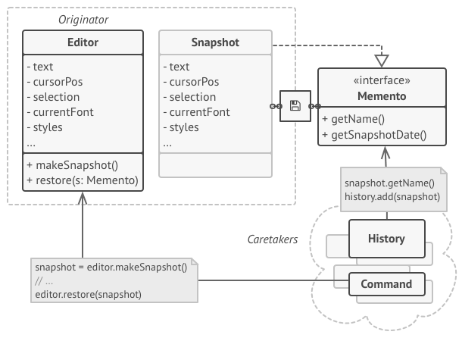
Memento
Concept
The Memento pattern delegates creating the state snapshots to the actual owner of that state, the originator object.
Copy of the object’s state in a special object called memento. The contents of the memento aren’t accessible to any other object except the one that produced it.
Caretakers store mementos. The caretaker works with the memento only via the limited interface.
Originator
Caretaker

Slide 6
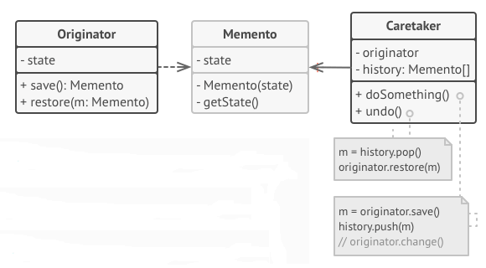
Participants
Class diagram
Memento – simple object that contains basic state storage and retrieval capabilities. It holds the internal state of an originator.
Originator – gets and sets values of mementoes. Creates new mementoes and assign values to them
Caretaker – hold and collect mementoes. It can store and retrieve mementoes.

Slide 7
Sequence diagram
Flow save
:Caretaker
:Originator
:Memento
A client (caretaker) requests a memento from the originator (to save the internal state of the originator)
save
new
return memento
Flow restore
A client (caretaker) pass a memento back to the originator (to restore to a previous state)
restore
getState

Slide 8
Memento Demo

Slide 9
Memento
Benefits
you can always discard the unwanted changes and restore it to an intended or stable state.
you can produce snapshots of the object’s state without violating its encapsulation.
provides an easy recovery technique.
you can simplify the originator’s code by letting the caretaker maintain the history of the originator’s state.

Slide 10
Memento
Pitfalls
the app might consume lots of RAM if clients create mementos too often.
caretakers should track the originator’s lifecycle to be able to destroy obsolete mementos.
it also increases maintenance costs in parallel because code efforts needs to be made to manage memento classes as well.
the additional time to save the states decreases the overall performance of the system.

Slide 11
Memento
Relation with other patterns
You can use Command and Memento together when implementing “undo”. In this case, commands are responsible for performing various operations over a target object, while mementos save the state of that object just before a command gets executed.
You can use Memento along with Iterator to capture the current iteration state and roll it back if necessary.

Slide 12
Memento
References
Design Patterns: Elements of Reusable Object-Oriented Software by Design Patterns: Elements of Reusable Object-Oriented Software by ErichGamma, RichardHelm, RalphJohnson, and JohnVlissides (the GangOfFour)
https://refactoring.guru/design-patterns/memento
https://www.tutorialspoint.com/design_pattern/memento_pattern.htm
https://howtodoinjava.com/design-patterns/behavioral/memento-design-pattern/
https://www.codeproject.com/Articles/517458/Practical-approach-to-Memento-design-pattern
https://howtodoinjava.com/design-patterns/behavioral/memento-design-pattern/

Slide 13
Memento
Questions and discussion

